Slide 1
Xtext and GEF deliver editors for the Open System Engineering Environment
Ryan Brooks
Ryan Schmitt
Boeing
Mesa, AZ

Slide 2
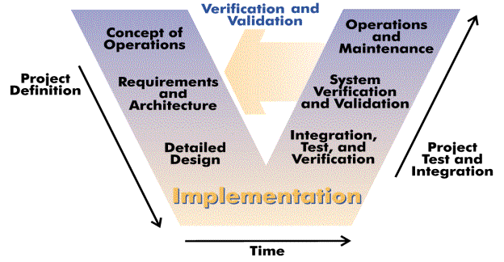
What is OSEE?
OSEE is a tightly integrated systems engineering environment designed to support lean engineering principles across a product's full life-cycle.
http://en.wikipedia.org/wiki/V-Model
V-model image is in the public domain

Slide 3
Third-Party Extensions and Legacy Software
Java/C/C++/Ada Dev
Backup/Restore
Multi Configuration
Project Mgmt/Planning
Building/Releasing
Team Config
Workflow Config
Metrics
Rich Traceability
Process Mgmt
Document Mgmt
Requirement Mgmt
Visualization
Blam Operations
Rules Framework
Publishing
Reporting
Messaging
Results Analyzer
Real Time Testing
Unit Testing
Reporting
Security
Task Scheduling
Database Analyzer
Training Services
Exemplary Applications Extensible Frameworks
Application
Development
Configuration
Management
Systems
Engineering
Requirements
Management
Testing
Environment
Eclipse Platform
OSEE Application Framework
Plugin Dev Utilities
Extensible Rendering
Remote Event Service
Indexing & Tagging
Dynamic Searching API
Dynamic Artifact Model
Multi-Level Transactions
Multi-Level Branching
Data Store Adapter
Access Control
Version Control
User Mgmt & Authentication
Object-Oriented Persistence
TPTP
Mylyn
Web Tools Platform
BIRT
Nebula
CDT
JDT
Other
Java Virtual Machine
OSGI
Relational DB (Oracle/PostGreSQL)
Operating System (Windows, Linux, OSX, Solaris)
Notes:
OSEE’s Architecture extends the Eclilpse Platform and provides it’s own extensions for use by the Applications that are built on top.
OSEE Application Framework provides the services necessary for the applications to share the common data model
Custom, Non-Engineering Environment Applications can be built on OSEE Application Framework and delivered to customers
Additional Applications can be plugged in to enhance OSEE’s already existing applications

Slide 4
OSEE Types Definition
Central to OSEE is a shared data model
Previously the data model was extended by adding custom OSEE types defined in Excel spreadsheets
New approach utilizes Xtext to generate an Eclipse editor that supports a domain specific language for defining OSEE types

Slide 5
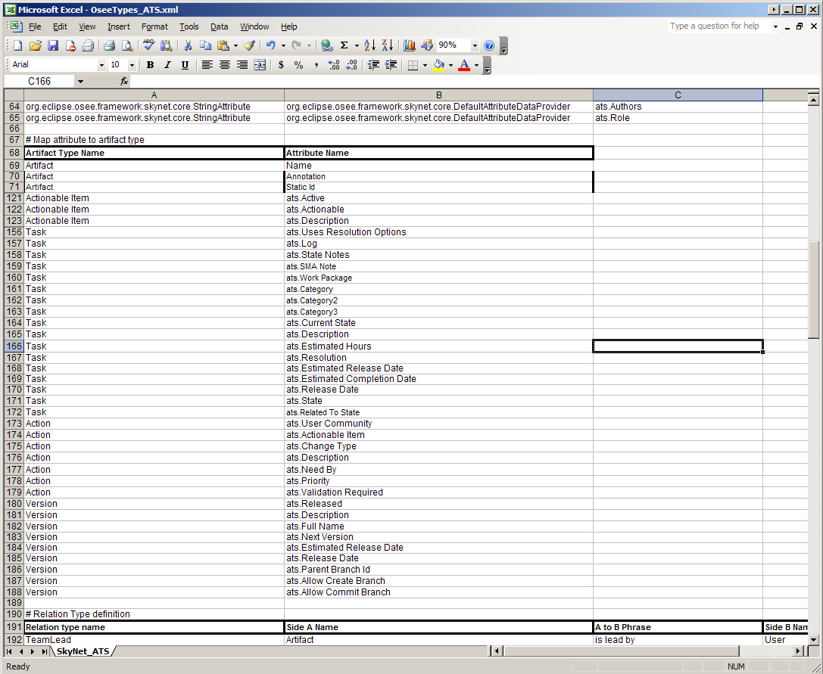

Slide 6
Weaknesses of Previous Approach
No syntax or semantics checking
Issues not found until runtime
Poor readability
No navigation support
No auto-complete
Limited visual clues
Required awkward sax parsing
Not stored using an open source format
Not integrated with Eclipse
Notes:
Limited visual clues (e.g. no syntax highlighting)

Slide 7
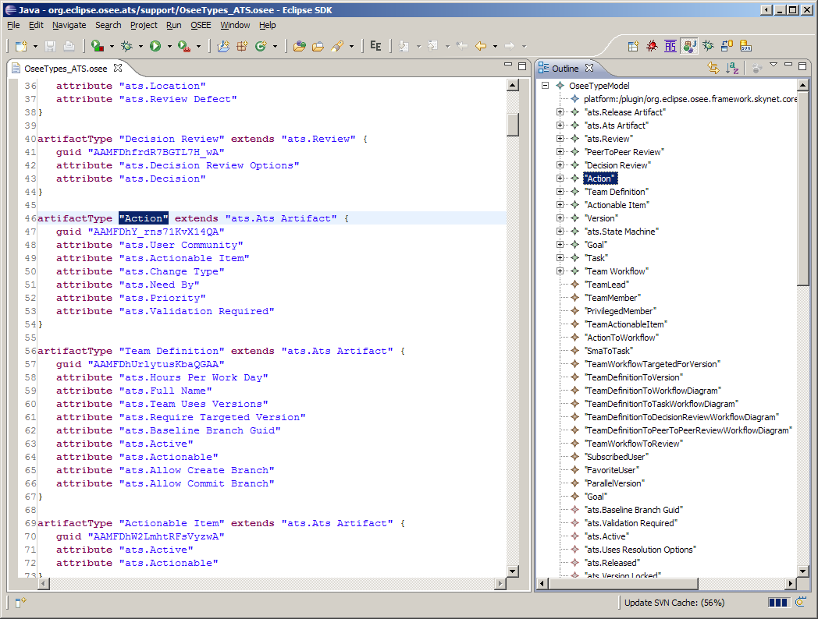
Notes:
You only need to define your grammar and Xtext takes care of the rest.
You don't need formal education on parsers and compilers.
The osee types grammer is less than 100 lines in Xtext.

Slide 8
ATS Workflow Configuration
Action Tracking System provides integrated change management in OSEE
Workflow configuration previously done in Visual Understanding Environment (VUE)
The Graphical Editing Framework (GEF) supports the creation of 2D graphical editors for Eclipse
OSEE now uses GEF to create a specialized workflow configuration editor

Slide 9
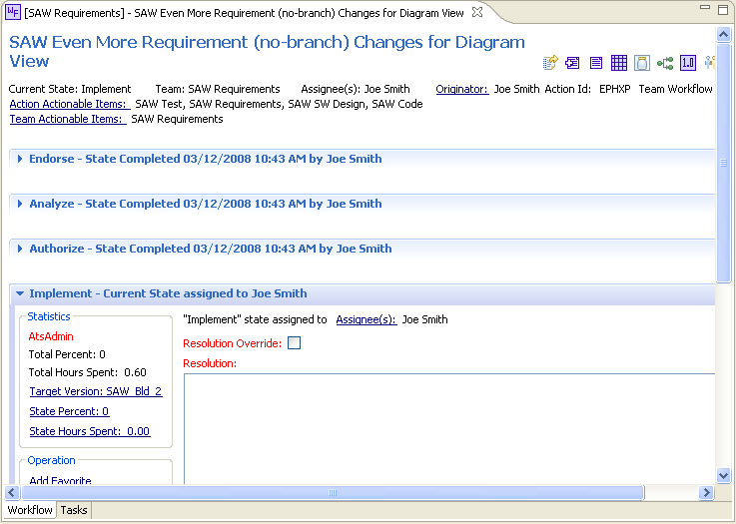
ATS Workflow Example

Slide 10
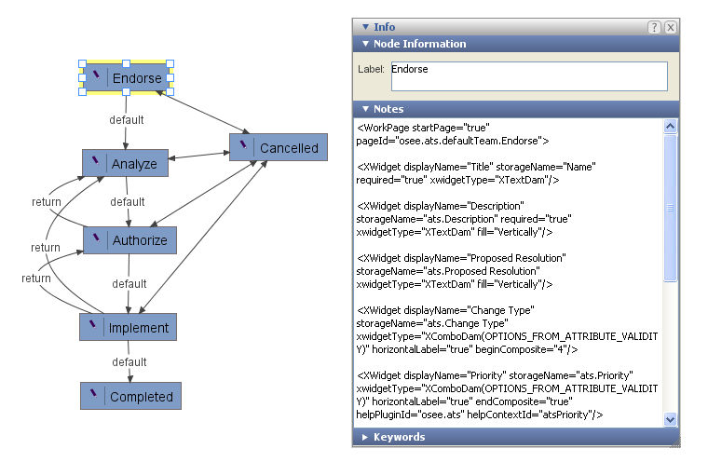
Workflow Configuration Using VUE
Notes:
Not integrated with Eclipse
Didn’t have junit tests involving VUE since it was a stand-alone application
Separate download and non-EPL license
Issues not found until runtime
Very general tool that offered no specific guideance to the user for configuring workflows

Slide 11
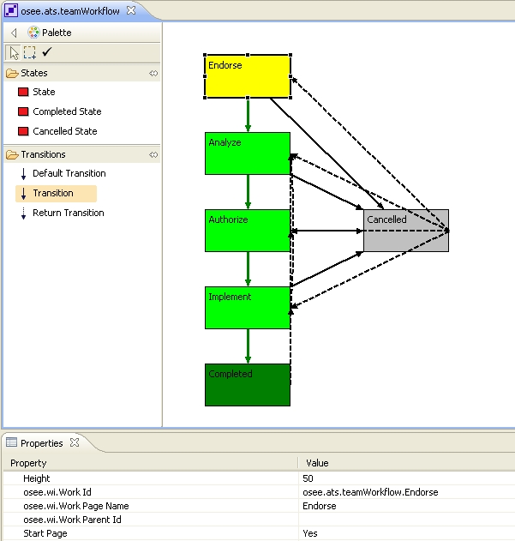
Workflow Configuration Using OSEE

Slide 12
Questions
Also, for more information please see http://www.eclipse.org/osee/

